Slide 1

Principles of Economics
Swagat Kishore Mishra
Lecturer, Dept. of Economics
Email: swagat@bits-goa.ac.in / sayswagat@gmail.com
VOIP: 207 PSRN: 485 CHAMBER: A-301/16
Tel. 0832-2580207 (O) 08879506995 (M)
Lecture-12

Slide 2
Contents
Case Study

Slide 3
Giffens Good
Giffen goods are pretty peculiar and are primarily a theoretical curiosity, but there are other situations where changes in prices might have “perverse” effects that, on reflection, turn out not to be so unreasonable.
For example, we normally think that if people get a higher wage they will work more.
But what if your wage went from $10 an hour to $1000 an hour? Would you really work more?
Might you not decide to work fewer hours and use some of the money you’ve earned to do other things?
What if your wage were $1,000,000 an hour? Wouldn’t you work less?

Slide 4
Rules any?
When the price of a good changes, there are two sorts of effects: the rate at which you can exchange one good for another changes, and the total purchasing power of your income is altered.
If, for example, good 1 becomes cheaper, it means that you have to give up less of good 2 to purchase good 1.
The change in the price of good 1 has changed the rate at which the market allows you to “substitute” good 2 for good 1.
The trade-off between the two goods that the market presents the consumer has changed.
Sample footer

Slide 5

Yes Rules apply.
At the same time, if good 1 becomes cheaper it means that your money income will buy more of good 1.
The purchasing power of your money has gone up; although the number of dollars you have is the same, the amount that they will buy has increased.
Sample footer

Slide 6
Decomposition of Price Effect
The first part—the change in demand due to the change in the rate of exchange between the two goods—is called the substitution effect.
The second effect—the change in demand due to having more purchasing power—is called the income effect.
Sample footer

Slide 7
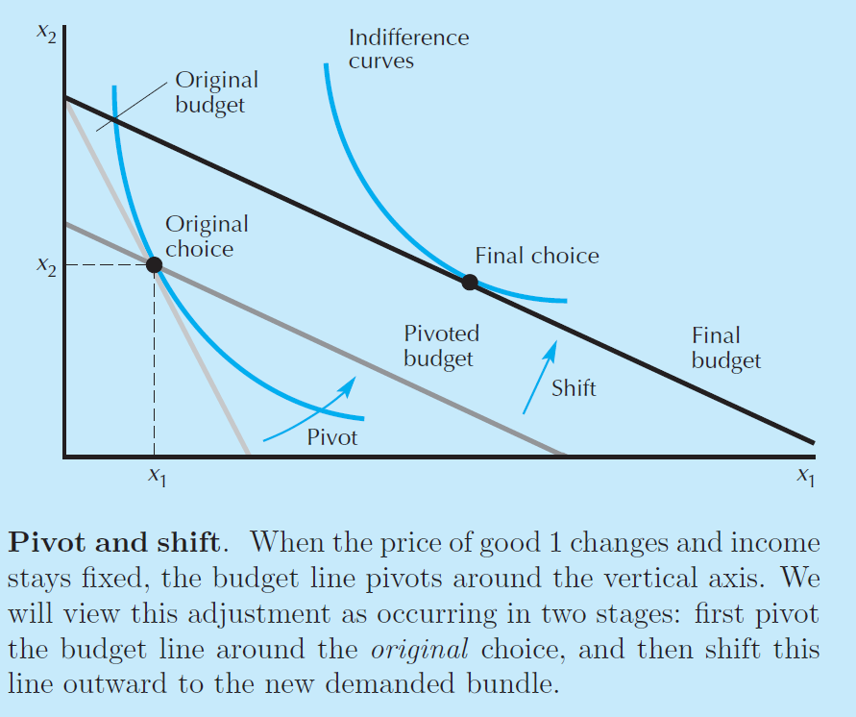
Figure: 1

Slide 8
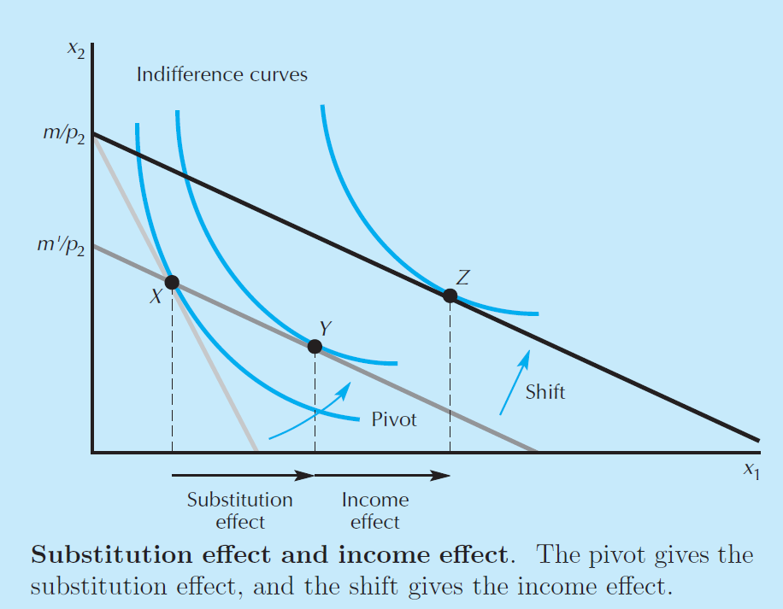
Figure: 2

Slide 9
Giffen behaviour found?
Oh Yes!
This paper provides the first real-world evidence of Giffen behavior, i.e., upward sloping demand.
Subsidizing the prices of dietary staples for extremely poor households in two provinces of China, we find strong evidence of Giffen behavior for rice in Hunan, and weaker evidence for wheat in Gansu.
The data provide new insight into the consumption behavior of the poor, who act as though maximizing utility subject to subsistence concerns, with both demand and calorie elasticities depending significantly, and non-linearly, on the severity of their poverty.
Understanding this heterogeneity is important for the effective design of welfare programs for the poor.

Slide 10
Quote:
As Mr. Giffen has pointed out, a rise in the price of bread makes so large a drain on the resources of the poorer laboring families and raises so much the marginal utility of money to them, that they are forced to curtail their consumption of meat and the more expensive farinaceous foods: and, bread being still the cheapest food which they can get and will take, they consume more, and not less of it.

Slide 11
Snob or Veblen effects same?
We use the term “Giffen behavior” rather than “Giffen good” to emphasize that the Giffen property is one that holds for particular consumers in a particular situation and therefore depends on, among other things, prices and wealth. Thus, it is not the good that is Giffen, but the consumers’ behavior. The Giffen phenomenon should also not be confused with prestige or Veblen goods, where consumers desire the goods precisely because the price is high, “snob appeal,” where consumers desire the good because it is rare, or situations where consumers interpret a high price as a signal of high quality. In all three cases, the goods in question are normal. Giffen behavior is a phenomenon that arises entirely within the neoclassical framework where consumers care about price only in as much as it affects their budget sets. If demand is Giffen the good in question must also be inferior, which rules out Veblen, snob and signaling effects.

Slide 12
Thanking
BITS PILANI, K.K.BIRLA GOA CAMPUS
Under the aegis of
Department of Economics
Dr. Mridula Goel (HOD)
Dr. Debashish Pattanaik
Dr. Aswini Kumar Mishra
Dr. Kubendran N.
Dr. Indranil De
Ms. Ambili K.
Mr. Swagat Kishore Mishra

